Slide 1

Understanding Join Conditions in Power BI

Slide 2
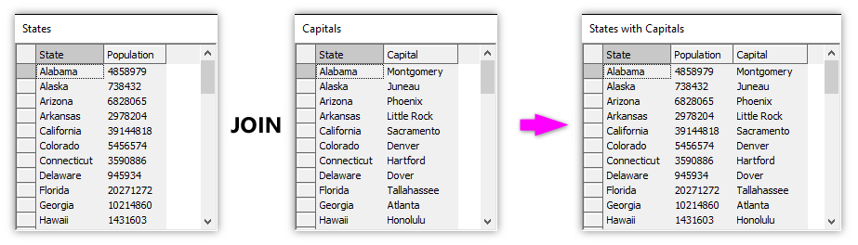
What Are Join Conditions?

Slide 3
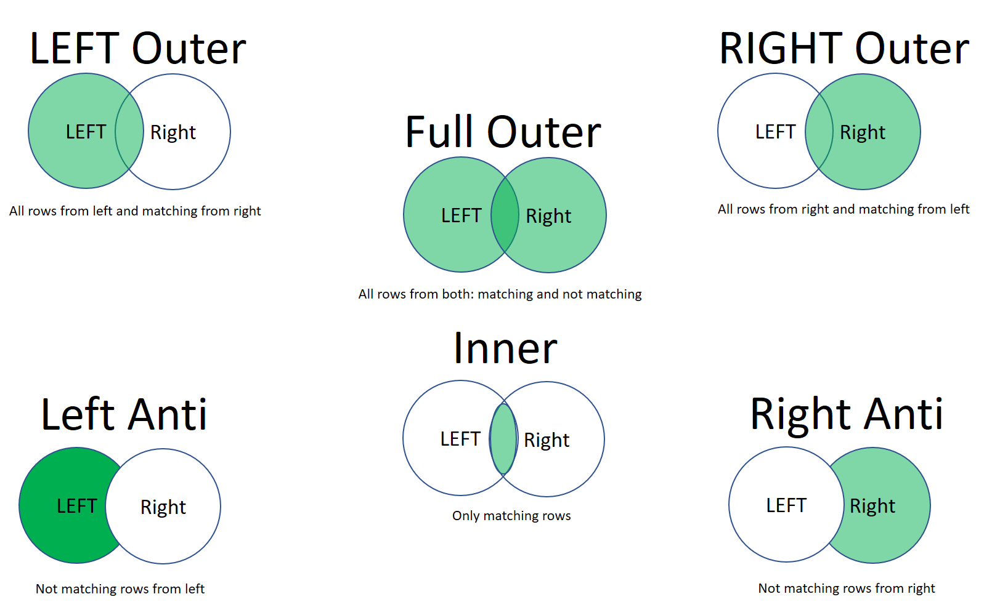
Types of Joins

Slide 4
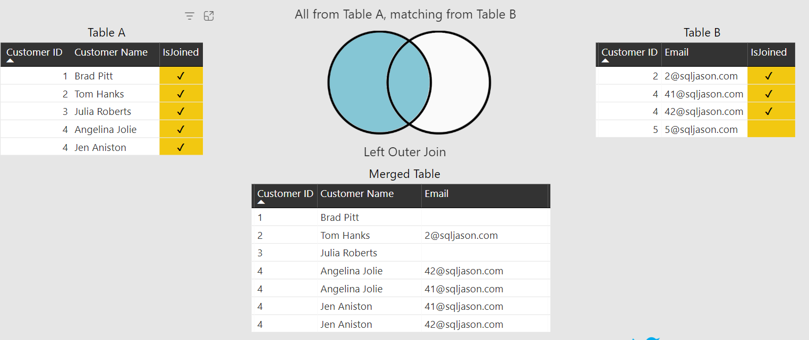
Left Outer Join

Slide 5
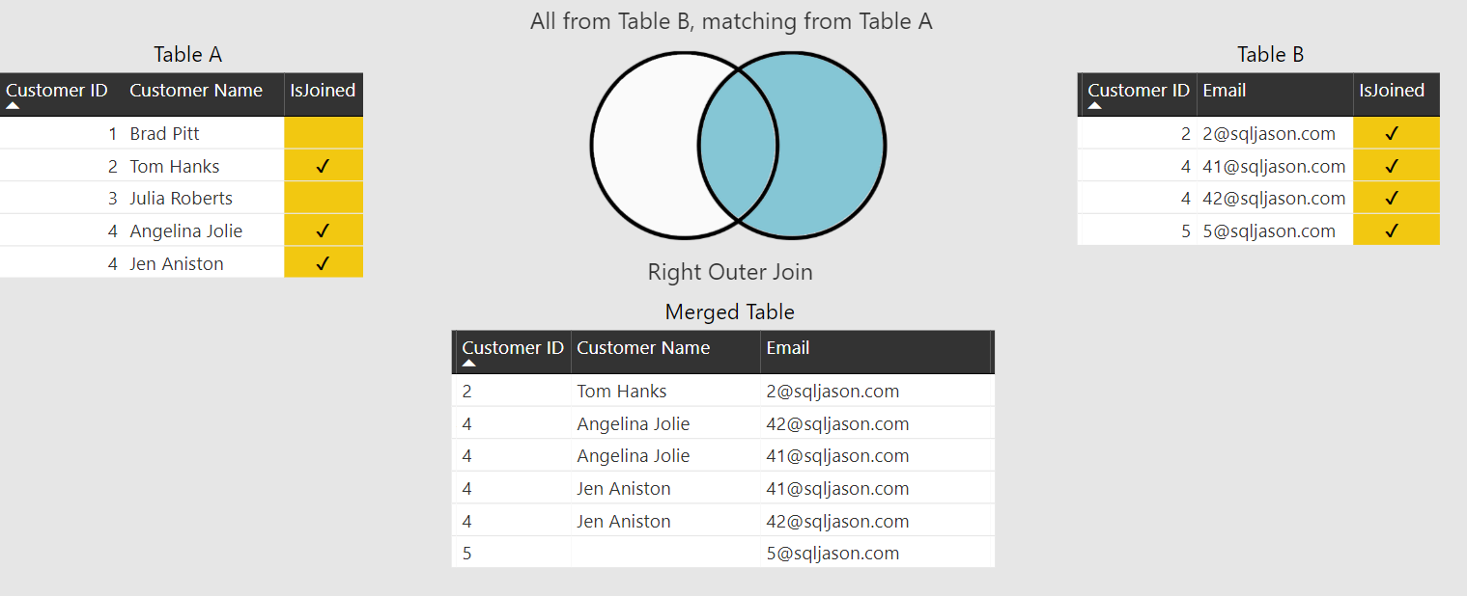
Right Outer Join

Slide 6
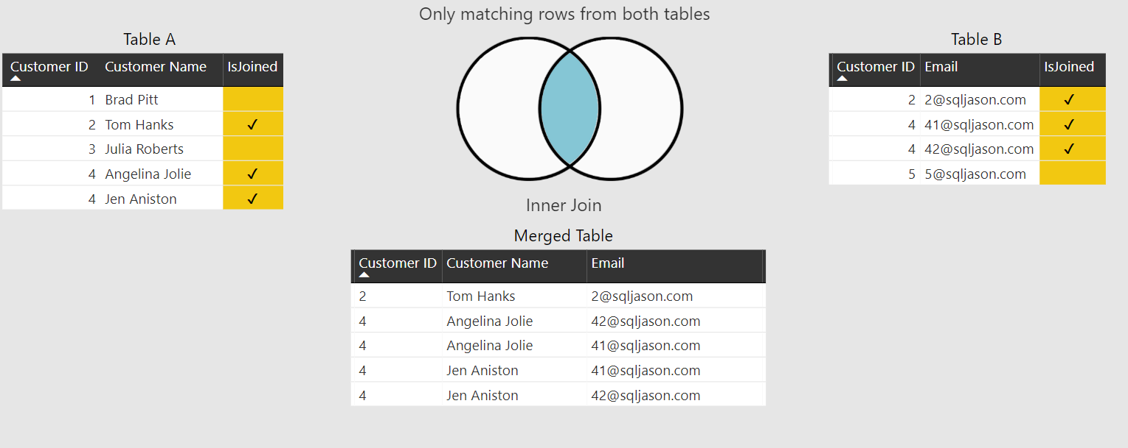
Inner Join

Slide 7
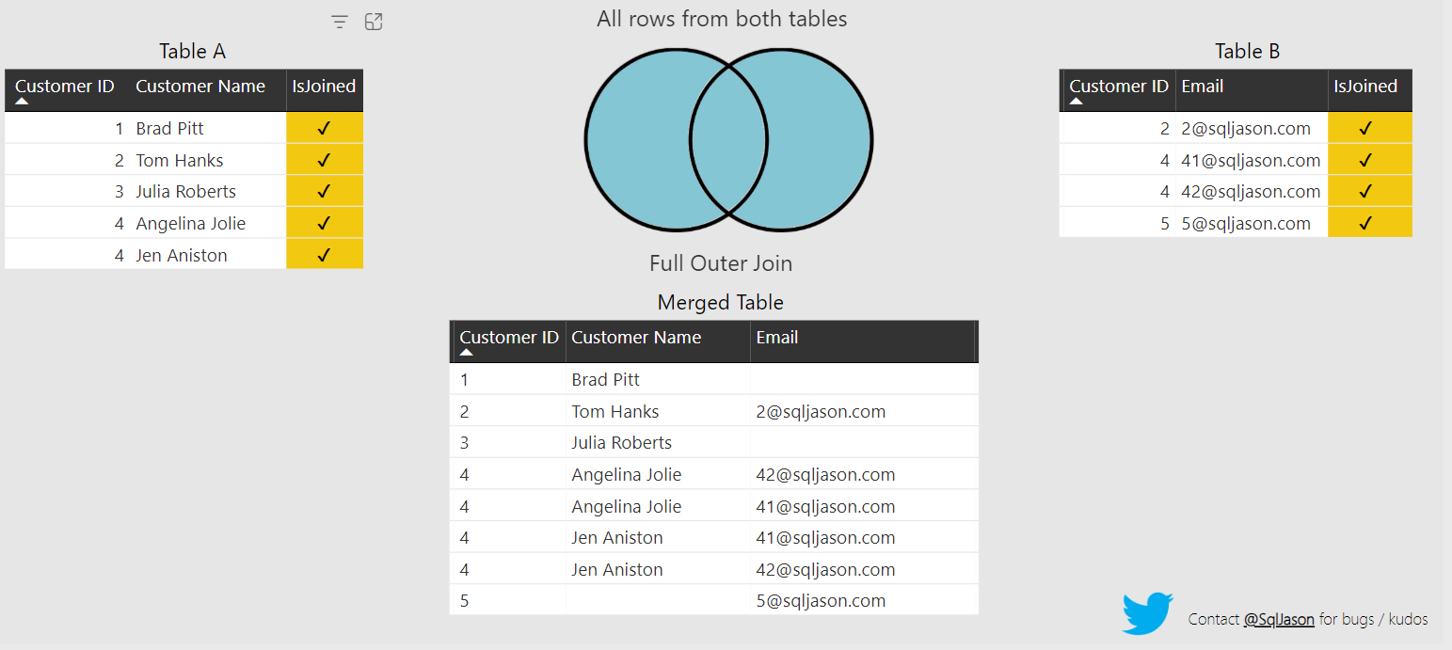
Full Outer Join

Slide 8
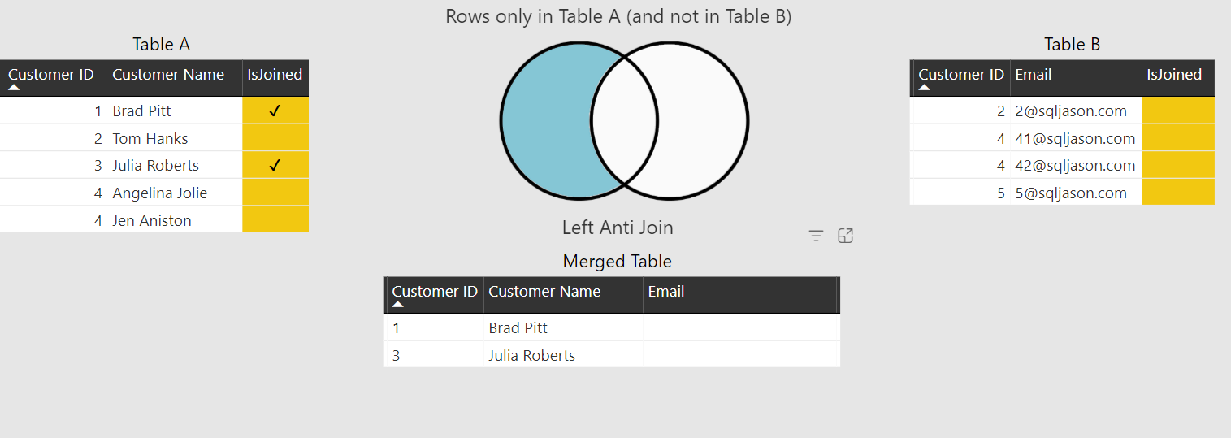
Left Anti Join

Slide 9
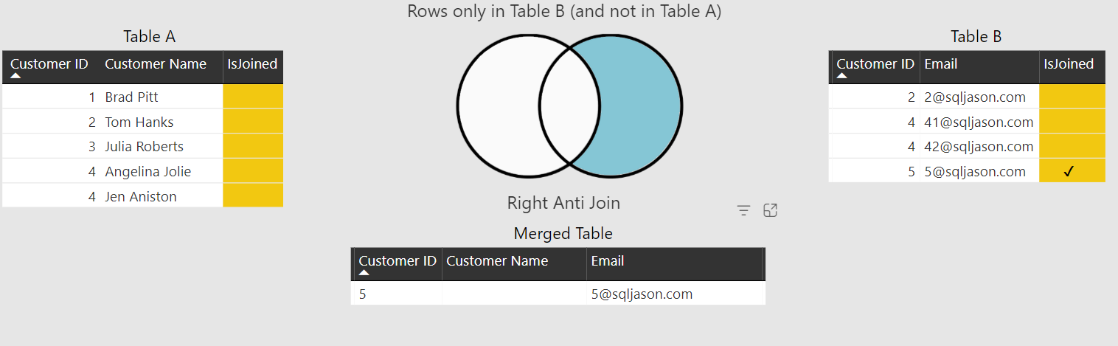
Right Anti Join

Slide 10
Q&A

Slide 11
Thank you

